Slide 1
Data LifeCycle Manager
Jagadeesh Saravanan
Arjun Sivagaminathan Mathan Kumar
Avanti Lagavankar

Slide 2
Why is it needed ??
To store and access the data efficiently
Cost efficiency: Higher cost memory is used to store more frequently used data
Latency: Data which is accessed more frequently must be available at low latency

Slide 3
What it means
Data LifeCycle Management includes:
Analyse the access pattern of the data
Authorize the valid users
Prioritize the data
Dispose

Slide 4
Objective
Develop an Application and provide as a service to organization
Not a system architectural change

Slide 5
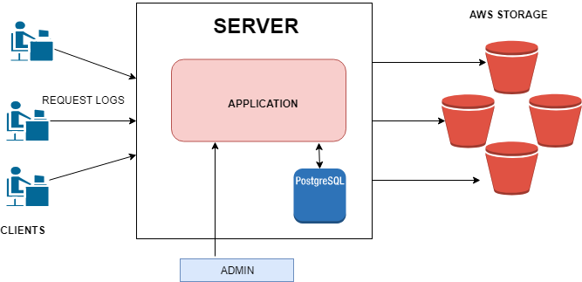
Architecture

Slide 6
Workflow
An admin has an overall control over the application
A number of clients are given access to AWS
A server hears for TCP requests from clients
Data access calculations and tiering decisions performed by server

Slide 7
Client
Registered to system by admin
Performs PUT and GET requests to AWS
Sends log information to the server

Slide 8
Server
Receives log information from clients
Updates the bucket information table using the log information
Calculates frequency per bucket object per cycle
Derives cumulative frequency
Implements the tiering policy based on the threshold

Slide 9
Our Business Scenario
Solution with S3 as storage
Enterprise or user level
Eg. Managing storage in an Enterprise that leverages AWS S3 as primary storage

Slide 10
Implementation
Started with a approach which eventually failed
Considered fitting attributes and devised a better solution

Slide 11
Failed Implementation
More Importance given to last accessed time and last modified time parameters
How it failed?
Incorrect results obtained when last accessed time and request count was considered over frequency.
Cannot depend on last modified as object may be accessed before it is modified.

Slide 12
Better Implementation
Factors Considered
Object creation time
Monitor over range of period / cycles
Cycle start and end time
Request count and frequency of access

Slide 13
Policy
Taken two access patterns into consideration :
Normal Distribution and Random Access
For Normal Distribution, (𝛍-2𝜎) is chosen as threshold
For For Random Access Pattern average of frequencies over ‘n’ cycles is chosen as the threshold

Slide 14
Challenges and Tradeoff
Fixing a criteria for threshold
Single person monitoring entire organization storage
Admin has to set threshold for each object

Slide 15
Why Our Solution ??
Each client cannot take time and design an policy
Admin responsibility to perform data management
AWS by default does not tier data unless mentioned by client
So...clients need help !!!

Slide 16
Underlying Technology and Frameworks
Django web framework
Python
Boto3 - AWS SDK for Python
PostgreSQL

Slide 17
Thank You !!! Questions ?

